Slide 1
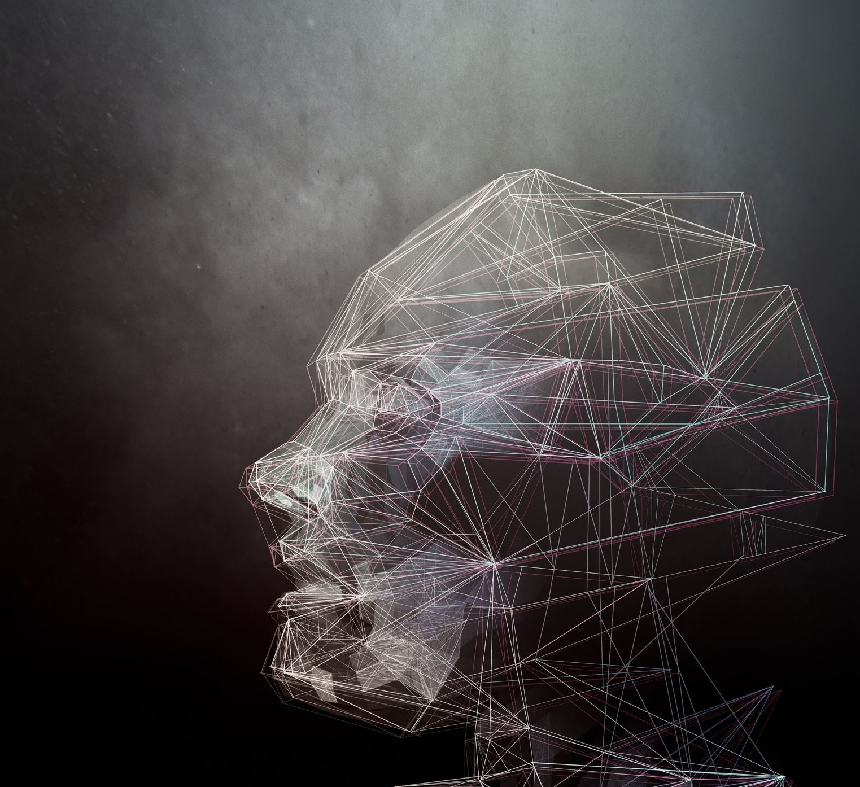
Analyzing the Vulnerabilities of InsightFace against Blackbox Attacks: A Comprehensive Security Analysis
CISC 850: Final Presentation
Group:
Nafiz Sadman
Elyas Rashno
Kazi Amit Hasan

Slide 2





Introduction, Related Work, Experiment and Results, Limitation, Conclusion
How ?
Input
Detection
Extraction
Decision
Recognition

Slide 3

Introduction, Related Work, Experiment and Results, Limitation, Conclusion
What ?
Fake Input
Detection
Extraction
Manipulated Decision
Adversarial Recognition

Slide 4
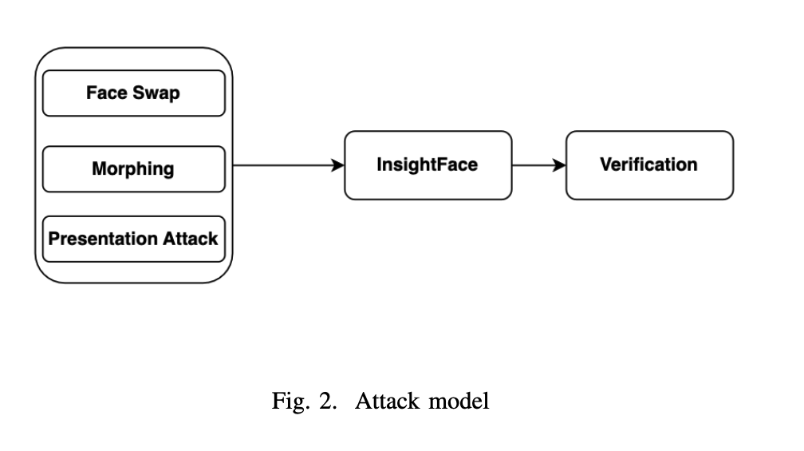
Introduction, Related Work, Experiment and Results, Limitation, Conclusion
Input attacks
Face Swap[6]: Replacing the face of a person in an image or video with the face of another person.
Morphing[6]: Combining two or more faces to create a new face that looks like a blend of the original faces.
Presentation Attack (Physical)[8]: Using a physical object, such as a mask, to impersonate a legitimate user and gain access to a system.

Slide 5
Introduction, Related Work, Experiment and Results, Limitation, Conclusion
Contributions:
Development of an attack model capable of generating manipulated images that can be utilized as input for the InsightFace system.
Comprehensive analysis and assessment of InsightFace’s security against potential threats and vulnerabilities.

Slide 6

Introduction, Related Work, Experiment and Results, Limitation, Conclusion
Why InsightFace?
An open-source deep learning project for face recognition.
Developed by the InsightFace* team at the Chinese University of Hong Kong.
Uses Convolutional Neural Networks (CNNs) to extract features from face images.
Uses extracted features to identify individuals.
A variety of face recognition tasks, including face verification, face identification, and face clustering.
Used ArcFace, MTCNN, RetinaFace, and ResNet models.
Was trained by normalized MS1M and VGG2 datasets
* https://insightface.ai/

Slide 7
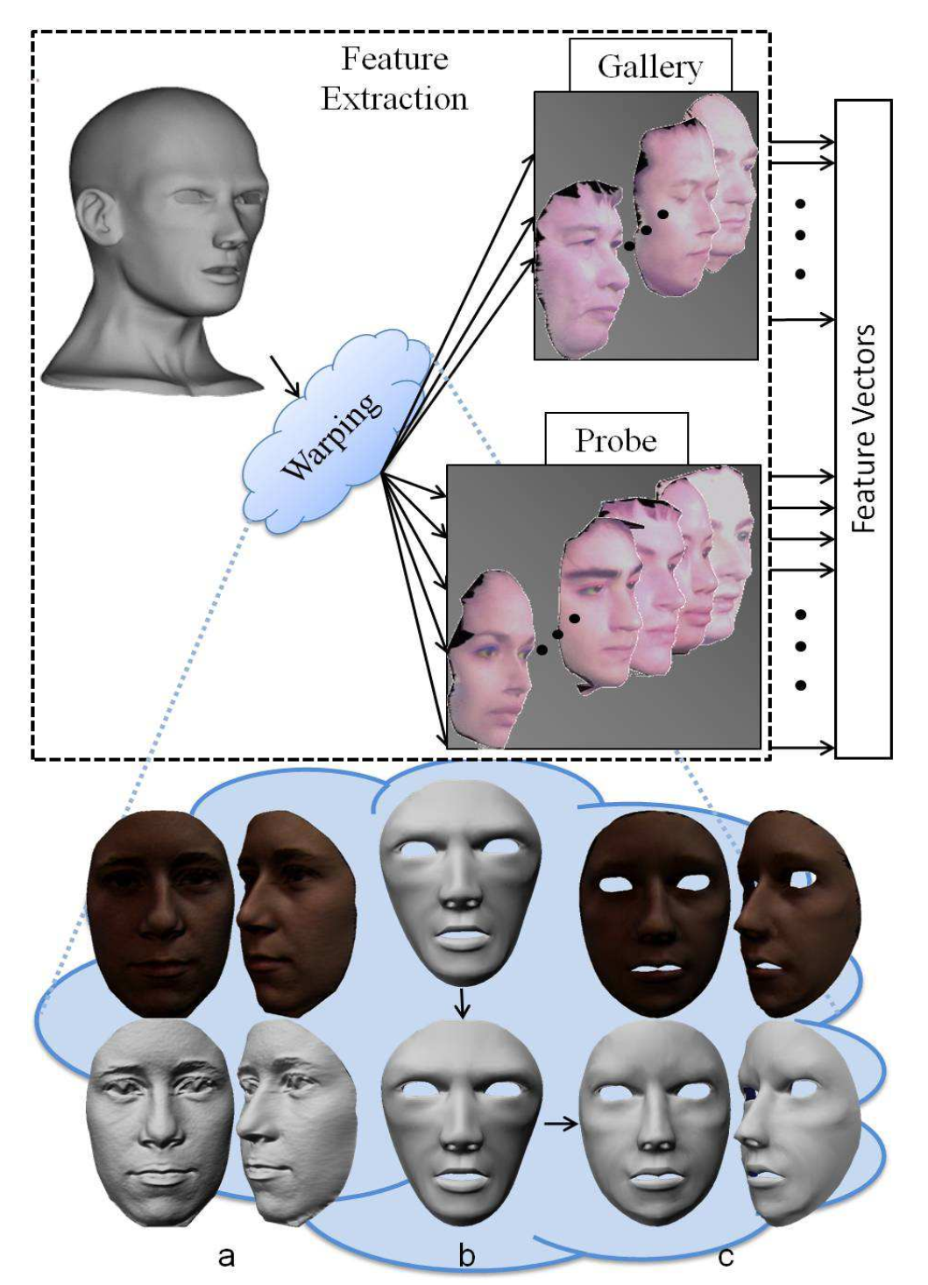
Introduction, Related Work, Experiment and Results, Limitation, Conclusion
ON THE VULNERABILITY OF FACE RECOGNITION SYSTEMS TO SPOOFING MASK ATTACKS
Demonstrating the impact of mask attacks on 2D, 2.5D and 3D face recognition systems
The mask attacks database which is used in this study was created by MORPHO
The selected face recognition system is a baseline system in TABULA RASA project
Multimedia Department, EURECOM, Sophia-Antipolis, France , IEEE conference

Slide 8
Introduction, Related Work, Experiment and Results, Limitation, Conclusion
On the Vulnerability of Face Recognition Systems Towards Morphed Face Attacks
Investigated the vulnerability of biometric systems to such morphed face attacks by evaluating the techniques proposed to detect morphed face images
A new database of morphed images is presented, which consists of printed and scanned images derived from digitally morphed images
They use both a commercial system - Neurotechnology VeriLook SDK and a publicly available FRS - OpenFace (based on a pretrained Deep Neural Network (DNN).
Biometrics and Internet Security Research Group, Hochschule Darmstadt, Germany- IEEE Conference 2017

Slide 9
Introduction, Related Work, Experiment and Results, Limitation, Conclusion
On the Vulnerability of Extended Multispectral Face Recognition Systems Towards Presentation Attacks
Demonstrated and evaluated the vulnerability of an extended Multispectral face recognition system
System captures the face image across various spectral bands and propose to study each of these spectral bands for the vulnerability towards presentation attacks
created the face artefacts using two different printers, which include laser and inkjet printers
evaluated the state-of-the-art Presentation Attack Detection (PAD) algorithms that are widely employed in conventional face PAD systems
Norwegian Biometrics Laboratory, NTNU - Gjøvik, Norway- IEEE conference 2017

Slide 10
Introduction, Related Work, Experiment and Results, Limitation, Conclusion
Overall Methodology

Slide 11
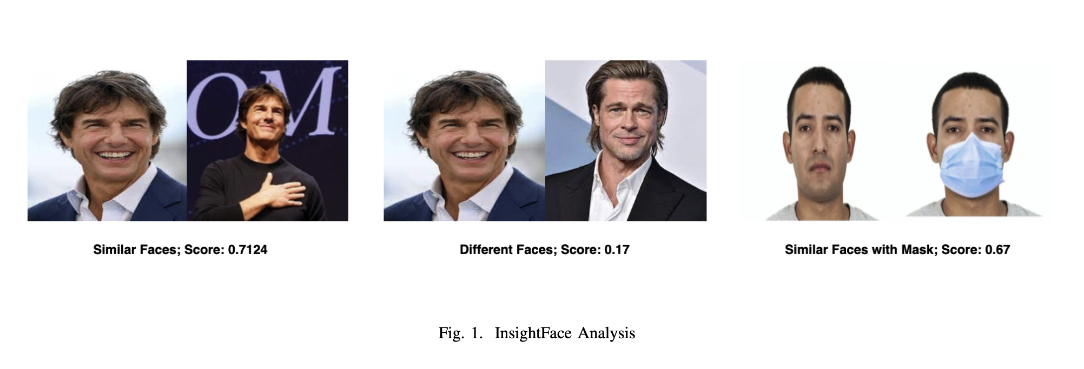
Introduction, Related Work, Experiment and Results, Limitation, Conclusion
Insight Face Analysis
Demo: http://demo.insightface.ai:7008/
Used faces of real humans.
Generated manual test cases from three perspectives:
Similar Faces
Different Faces
Similar faces with mask

Slide 12
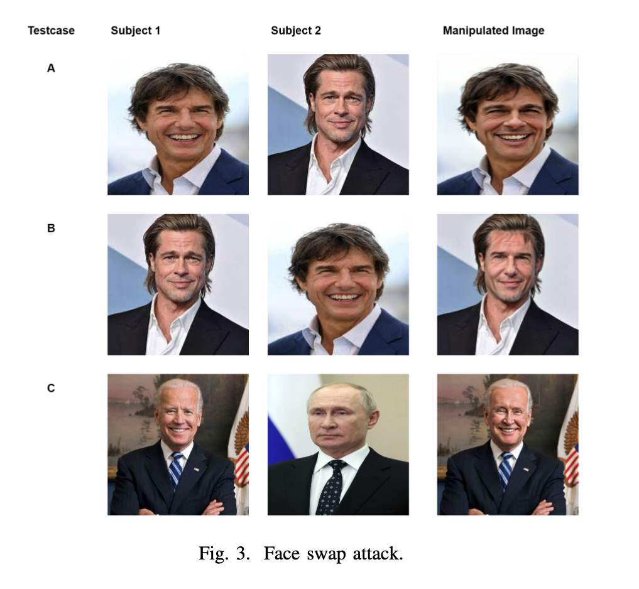
Introduction, Related Work, Experiment and Results, Limitation, Conclusion
Implementing Face Swap Attacks
Used Faceswapper.ai an online tool that uses generative adversarial networks to swap the face of one image to the other

Slide 13
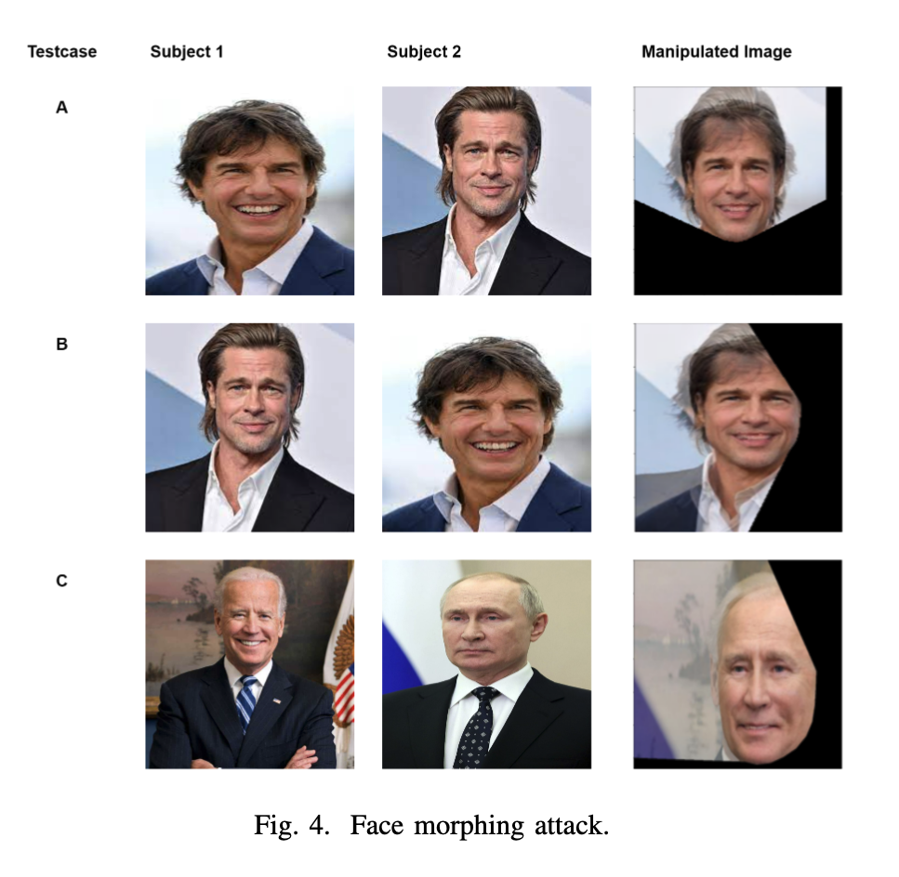
Introduction, Related Work, Experiment and Results, Limitation, Conclusion
Implementing Morphing Attacks
Constructed our algorithm by using Python’s Deep learning library (Dlib) 68 face landmark detection model to detect landmark points on the faces.
Delaunay triangulation is used to give better triangular meshes in a two-dimensional image plane to represent a natural face segmentation
The two landmarks are then matched and plotted on top of each other to create a morphed image.

Slide 14
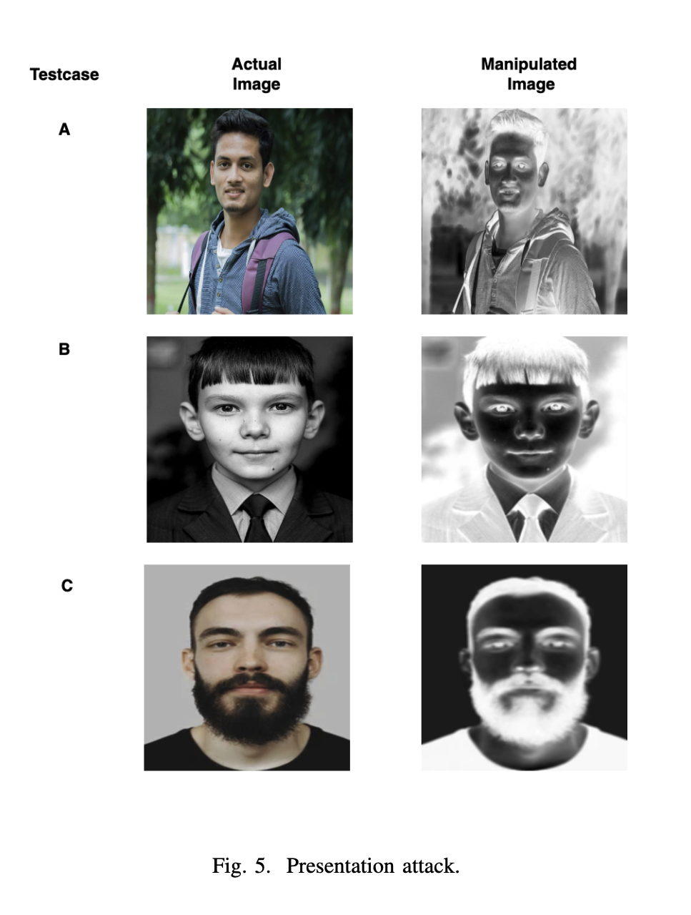
Introduction, Related Work, Experiment and Results, Limitation, Conclusion
Implementing Presentation Attacks
Print attack is a type of presentation attack
We couldn’t find any open sourced algorithm to initiate print attack. So, we created one!
Algorithm involved converting the image to grayscale, applying a blur filter, inverting its colors, and enhancing its contrast.
These transformations may aid in accentuating certain features or artifacts within the image that could be indicative of a presentation attack.

Slide 15
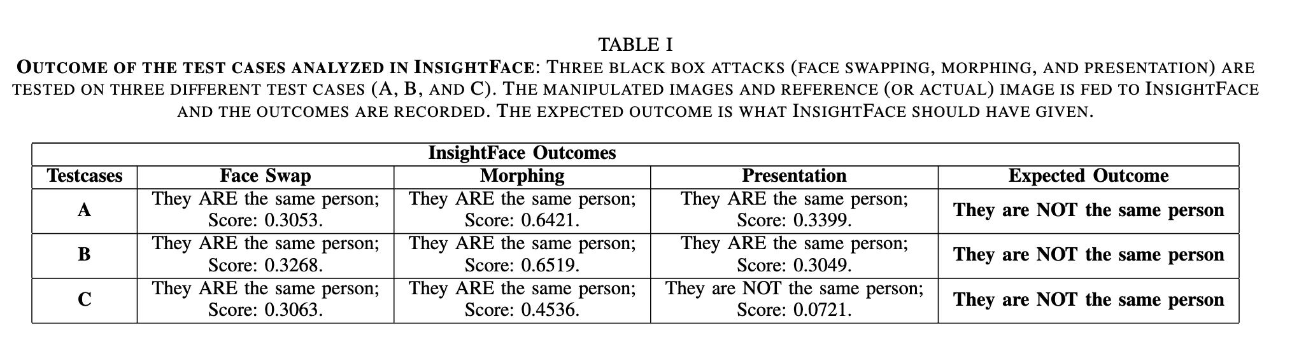
Introduction, Related Work, Experiment and Results, Limitation, Conclusion
Analyzing the InsightFace Outcomes

Slide 16
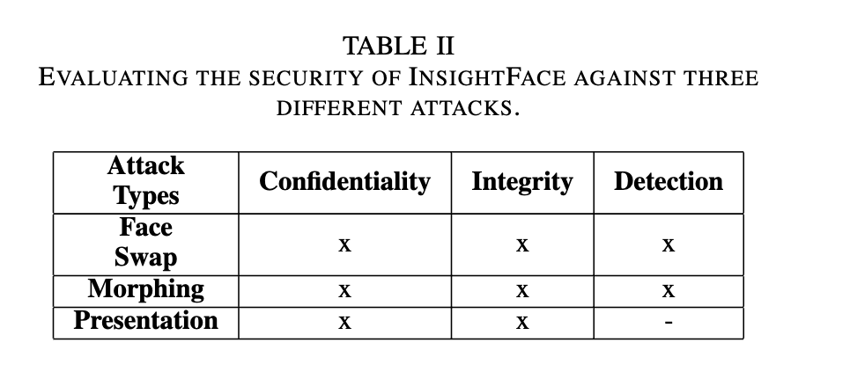
Introduction, Related Work, Experiment and Results, Limitation, Conclusion
Evaluating the attacks
Confidentiality: Can we authenticate an attacker?
Integrity: Does the attack change the image?
Detection: Can the system classify the identity of the intended user?

Slide 17
Introduction, Related Work, Experiment and Results, Limitation, Conclusion
The first limitation is that a white box attack will not be implemented due to time constraints and the complexity of the project source code.
The second limitation is that the project has only been tested with a few common black-box attacks.
Implemented:
Face Swap/Deep Fake
Face Morphing
Presentation Attack
Attack Model
Evaluation Strategy
Future Work:
Master Face
Defense Model

Slide 18
Introduction, Related Work, Experiment and Results, Limitation, Conclusion
Analyzed the security of the InsightFace project against three black box attacks (face swap, morphing, and presentation) in terms of confidentiality, integrity, and detection
Various types of faces such as gender, race, age
Protecting the system against various types of attacks such as morphing faces, presentation, and face swapping can be achieved through various methods

Slide 19
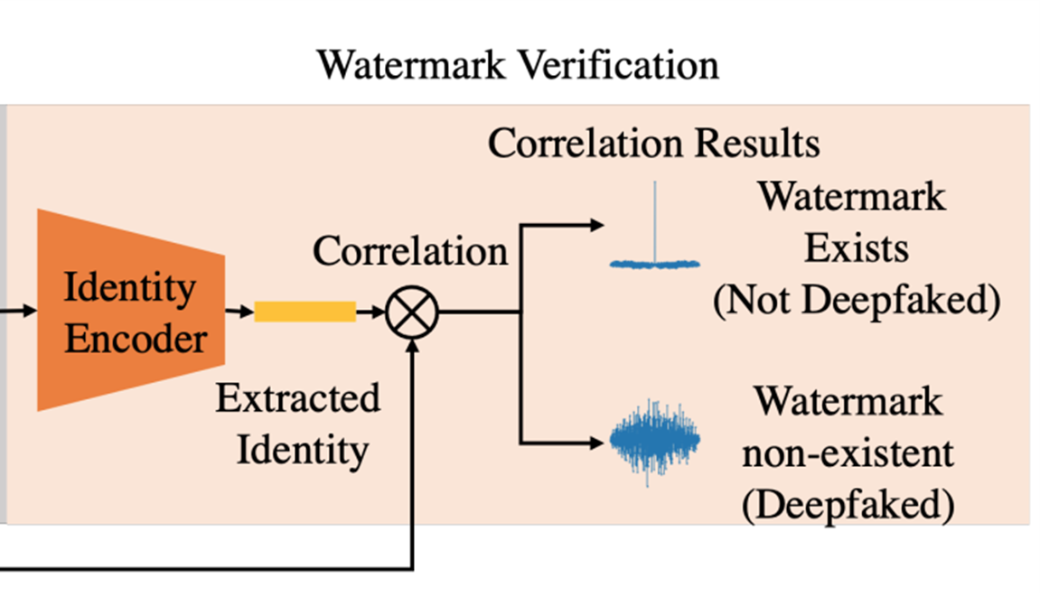
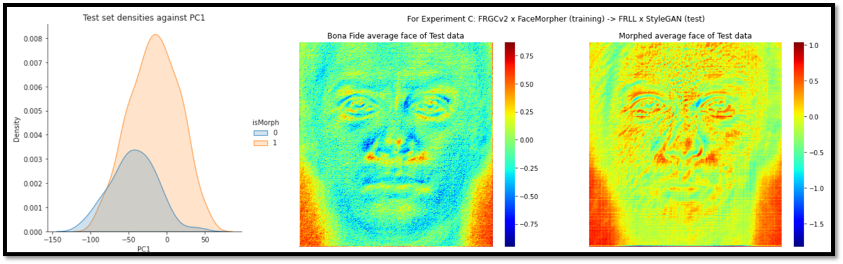
Introduction, Related Work, Experiment and Results, Limitation, Conclusion
Proposed Defense
Watermark Injection [7]
Linear Binary Pattern + PCA [6]

Slide 20
References
Tang, Yong, et al. "Vehicle detection and recognition for intelligent traffic surveillance system." Multimedia tools and applications 76 (2017): 5817-5832.
Waseem, Muhammad, et al. "Face recognition for smart door lock system using hierarchical network." 2020 International Conference on Computational Intelligence (ICCI). IEEE, 2020.
Celine, Jinu. "Face recognition in CCTV systems." 2019 International Conference on Smart Systems and Inventive Technology (ICSSIT). IEEE, 2019.
Zuo, Fei, and P. H. N. De With. "Real-time embedded face recognition for smart home." IEEE transactions on consumer Electronics 51.1 (2005): 183-190.
Othman, Nashwan Adnan, and Ilhan Aydin. "A face recognition method in the Internet of Things for security applications in smart homes and cities." 2018 6th International Istanbul Smart Grids and Cities Congress and Fair (ICSG). IEEE, 2018.
Dargaud, Laurine, et al. "A Principal Component Analysis-Based Approach for Single Morphing Attack Detection." Proceedings of the IEEE/CVF Winter Conference on Applications of Computer Vision. 2023.
Zhao, Yuan, et al. "Proactive Deepfake Defence via Identity Watermarking." Proceedings of the IEEE/CVF Winter Conference on Applications of Computer Vision. 2023.
Nguyen, Huy H., et al. "Master face attacks on face recognition systems." IEEE Transactions on Biometrics, Behavior, and Identity Science 4.3 (2022): 398-411

Slide 21
Summary

